Slide 1
Cognitive Science for AI
Philosophy

Slide 2
Cognitive Science for AI - Philosophy
Determinism vs Free Will
Philosophy of Mind
Truth and Knowledge
Philosophy of Science
Philosophy of Language
Ethics

Slide 3
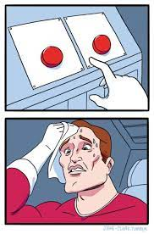
Control over Actions - Agency
How can Intelligence affect Reality? Are there choices?
Free Will - there are choices
All our intuition
All of Ethics/Law - responsibility
Determinism - there is no choice, ‘que sera sera’
Mechanistic world - Descartes - everything is a machine
Laplace’s Demon - position/velocity of all determines future
All of science strives for determinism
Logical vs Biological vs Psychological Determinism
Reconciliation?
Strict physical laws vs statistical distributions (non-determinism)
Monkey riding a tiger
https://plato.stanford.edu/entries/freewill/

Slide 4
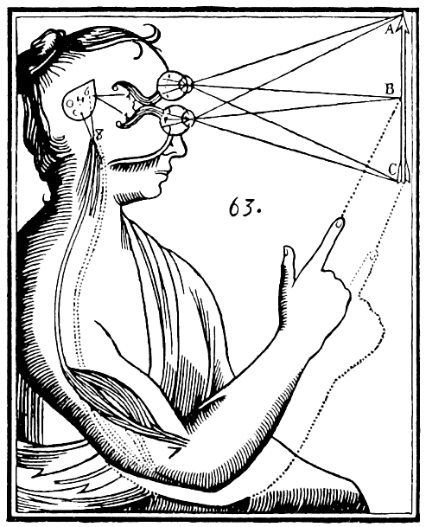
Philosophy of Mind
How do we get from ‘bag of chemicals’ to ‘thinking person’?
Dualism - body and mind are separate
Descartes - ‘cogito ergo sum’
Intuition says thoughts are a different from the body
Princess Catherine - but how do they connect if they are separate?
Materialism (Monism) - mind and body are the same
Behaviorism: Skinner - only external effects, ignore mental states
Idealism: Berkeley - everything is in the mind
Materialism: mind is an ‘epiphenomenon’ of physical processes
Functionalism - ignore implementation, just inputs and outputs
Jeff Kaplan lectures
What is it like to be a bat?
https://en.wikipedia.org/wiki/Mind%E2%80%93body_dualism#/media/File:Descartes_mind_and_body.gif

Slide 5
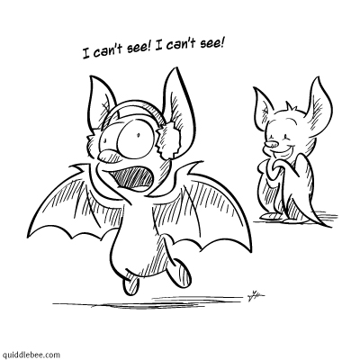
Consciousness
Being awake
Explicit knowledge (known knowns) vs implicit/intuitive knowledge
Executive function - goal directed behavior
Stream of consciousness - an inner sequence of words or imagery
Metacognition - ability to think about thoughts
Sensation of inner state that is processable, emotions, time
Inner awareness - between lack of knowledge and implicit knowledge
Theory of mind - realizing that other entities have minds, goals, desires
Qualia - instances of subjective experience
‘Ghost in the machine’, homunculus, the Cartesian stage****
https://www.goodreads.com/review/show/2690597304

Slide 6
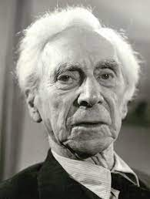

Epistemology - Where does Knowledge come from?
Rationalism - innateness
“reason is the chief source and test of knowledge”
Plato…Descartes, Leibniz, Kant
nature/DNA/what you are born with
Empiricism - environment, learned
Primarily sensory experience - ‘tabula rasa’ = blank slate
Aristotle…Ibn Sina…Locke, Berkeley, Hume…Vienna Circle
Problem of induction - Hume, Popper
nurture/experience

Slide 7
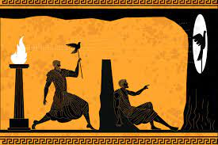
Theories of Truth
Plato’s Cave in ‘The Republic’
The truth is out there - we see a poor version of it
Correspondence - statements match ‘objective’ reality
Coherence - consistent and complete
Constructivist - contingent, created by history and agreement, social convention
Pragmatic - verified/confirmed by practice
https://plato.stanford.edu/entries/truth/

Slide 8
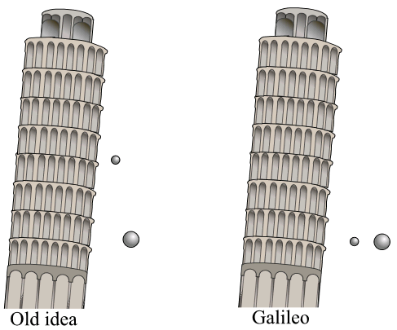
Philosophy of Science
Where does scientific knowledge come from?
Description - just look at what happens
Development of vocabulary, similarity/difference
Making Hypotheses and testing them - Galileo
The Scientific Method
The problem of induction - Hume
How do we know the sun will come up tomorrow?
How do we know that scientific laws predict the future?
Don’t throw out a theory because it fails one instance
Newtonian Mechanics is a very good approximation to Relativity (at a medium scale(
Engineering - putting science to practice
sometimes just doing it and it not breaking
Statistics - dealing with error, distributions
https://en.wikipedia.org/wiki/Galileo%27s_Leaning_Tower_of_Pisa_experiment#/media/File:Pisa_experiment.png

Slide 9
Philosophy of Science
Metascience
Logical Positivism
Verificationism - science is things we can verify
Falsification - Popper
Scientific theory/prediction - one that can be disproven by data
Demarcation between Natural Science and Metaphysics
Kuhn - progress is incremental, paradoxical, revolutionary
Normative vs Descriptive
What should be vs what is
Reductionism vs. Holism of scientific areas
“Psychology is Applied Biology is Applied Chemistry is Applied Physics is …”
vs “Each domain has its own fundamental laws”

Slide 10
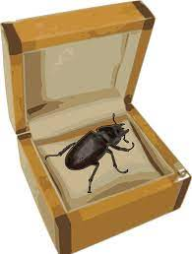
Philosophy of Language
Wittgenstein examples
What is a ‘game’? - ambiguity/vagueness
family resemblance
resolved by context
Beetle in a box
meaning -is- use
Sapir-Whorf hypothesis:
Strong: language determines thought
Weak: language structure influences one’s worldview
30 words for snow, NESW language
not really borne out by examples, experimentation.

Slide 11
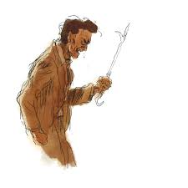
Theories of Ethics
Divine command - from authority (often religious)
Virtue Ethics - Plato, Aristotle - evil is the result of ignorance
Stoicism - peace of mind, self-control
Hedonism - do what gives the most pleasure
Consequentialism - result is key “The ends justify the means”
Utilitarianism - the greatest happiness for the greatest number
Deontological - act from duty, intention is key, Kant’s ‘categorical imperative’
Moral Relativism - it depends on the situation (this is not just ‘anything goes’)
Wait…what does this all have to do with -cognitive- science?
Why is this even here?
Wittgenstein’s Poker

Slide 12
Study of Learning
Child Development/Animal Behavior - how babies and animals develop and learn
Statistics/Machine Learning - mathematics and algorithms for fitting functions to data
History and Philosophy of Science - organizing thoughts about knowledge discovery
Psychological Learning
Biological Learning - Neurology
Evolution

Slide 13
Lessons from Philosophy
Things aren’t black and white
Shades of gray
Things overlap
Sometimes it is easier to split things down the middle
Things have more than one cause/component
It’s just easier to think of the one most important thing
Things aren’t simple
Things interact in multiple ways

Slide 14
Answers from Philosophy
“Philosophy never answers anything. It just provides more questions.”
“If philosophy ever solves anything, it’s no longer philosophy. It’s word play or it is science.”
But there are some philosophical answers (or at least what people have settled on)…
Dualism vs Materialism
Materialism
Intelligence, mind, and consciousness are founded on chemical processes in the brain
It’s what we work with, we just can’t work scientifically with dualism
Empiricism vs Rationalism
Both
A continuum (or many continua) - determine cutoff experimentally.for each property
Truth
There is (mostly) an objective reality
But there are lots of ways to perceive it in context and some subjectivity
Determinism vs Free Will:
Both (depends)
I have free will (I can make decisions for myself), but others (or machines) are controlled (deterministically or by statistical distribution)
Philosophy of Science:
Verification, falsification, and Statistics
If data can falsify it (and corroborate it) then it’s science. Else it’s metaphysics.
Philosophy of Language:
Only the weakest and simplest Sapir-Whorf holds.
Special vocab helps ease some thoughts. But everything can be translated.
Ethics
Principled pragmatics
Don’t go to logical extremes to justify ends

